Slide 1
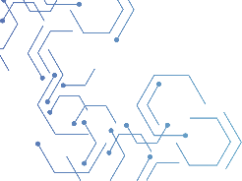

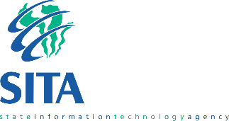

Slide 2

Content
Mobile Application – Continuous Delivery Platform
Q&A
Problem Statement
Mobile Application Strategy
Mobile Apps - Continuous Testing Strategy
SITA Mandate

Slide 3


Problem Statement
With the development of mobile applications, not only can government provide more information to citizens, but people who use the apps can in turn do the same for government.
Mobile apps are increasingly becoming an essential tool for how citizens interact with their government.
Mobile apps offer a wide range of opportunities for government in delivering services, as well as engaging citizens in co-producing services.
Therefore creative ways of using mobile apps for government continue to multiply, since these apps allow for quicker response from both citizens and government; they can help in emergency situations and allow citizens to gather information that otherwise may be harder to find if they had to look up an agency or search the web.
The digital era is here to stay and government entities recognize the need to provide citizens and employees with instant access to information and real time updates.

Slide 4
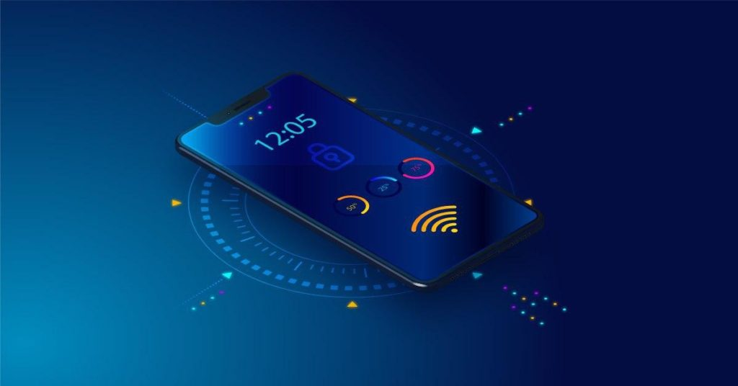
SITA Mandate
To improve service delivery to the public through the provision of information technology, information systems and related services in a maintained information systems security environment

Slide 5

SITA Mobile Application – Strategy
Enterprise Focused
Citizen Focused
Enterprise focused app: for internal use to help government employees do their job more efficiently and effectively by giving them a central point to communicate and collaborate.
Citizen focused app: for citizens to be able to obtain real time information, public services and engagement for innovation services.
Customer service improvements are very important at the state and local levels as they are the direct service providers to citizens on a day-to-day basis (e.g., schools, hospitals, law enforcement, public works, transportation, etc.). Hence, there’s a huge requirement for state and local governments to develop apps aimed to facilitate citizen engagement.

Slide 6
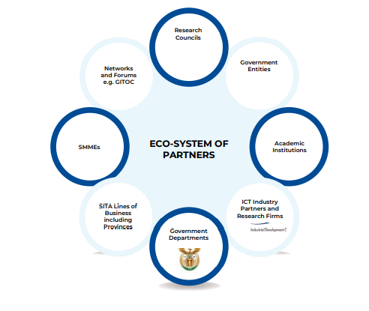
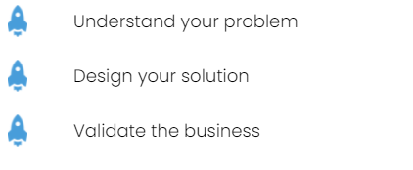
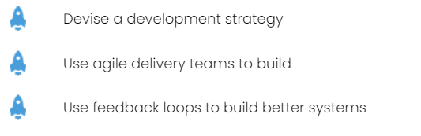
Mobile Application – Engagement Model

Slide 7
Mobile Application – Continuous Delivery Model
The SITA strategy explicitly envisaged doing mobile app development “right” from the beginning.
Premised on four principles to:
Create an information-centric government that focuses on open data and content
Establish a shared platform within and across entities
Take a customer-centric approach in presenting data
Build required security and privacy measures upfront
Utilization Mobile apps use APIs to access data from several organizations to provide value-added services in real time and place.

Slide 8
Mobile Application – Continuous Delivery Model
Challenges when Developing Mobile Apps
  IT infrastructure – Most government departments do not have up-to-date IT infrastructure
  Lack of app developers – entities may not have employees with the know-how to develop an app, meaning they would have to engage an outside contractor
  Cost – Developing an app can get quite expensive
  Device compatibility – Making sure the app works properly and looks good on all devices
  Easy-to-use interface – Making sure the app is simple to use
  Continuous Testing – ensure that the quality, usability, and security of your mobile app not only meets expectations but exceeds them.
  Time frame – From development to launch, the process could take up to a year or more

Slide 9
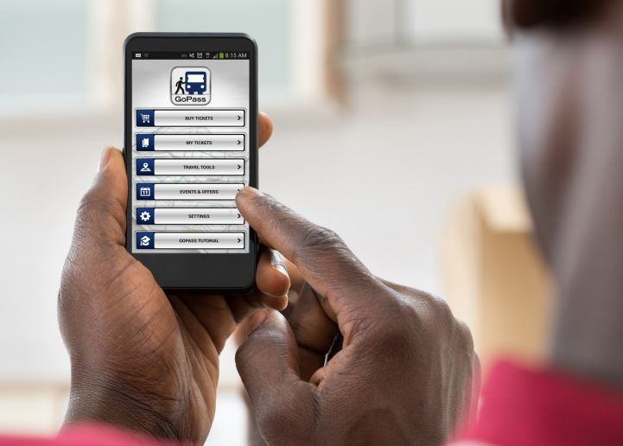
Mobile Application – Continuous Testing
Continuous Mobile Testing enables increased release in mobile app development velocity while providing customers with satisfying, error-free experiences across all devices and browsers.
Benefits
Improves the quality, usability, and security of your mobile app and ensures the solution not only meets expectations but exceeds them.
Provides a “third-party” assessment of the ease with which end users view content or execute an application on a mobile device.
Testing your app plays an important role especially while you are going live to the public.
Get an opportunity to test your Mobile App on most popular devices

Slide 10

Mobile Application – Continuous Testing
With the incredible growth in mobile applications, developers are expected to deliver high-quality applications within budget and on time.
Therefore, mobile application testing has become a vital part of mobile application development.
People abandon apps without thinking twice because of security and gadget performance concerns.
If users uninstall your app because of bugs, it ruins your reputation.

Slide 11
Mobile Application – Continuous Testing
Therefore, it is necessary to test your apps before launching for users to download
Mobile application continuous testing is a process through which mobile apps developed for handheld mobile devices are tested automatically or manually for consistency, usability, and functionality.
The majority of issues faced by a mobile application will be addressed through thorough testing, which also helps guarantee the quality of the application.
Mobile app stores, almost half of the negative reviews are due to concerns such as battery drain, poor performance, and crashes, etc.

Slide 12
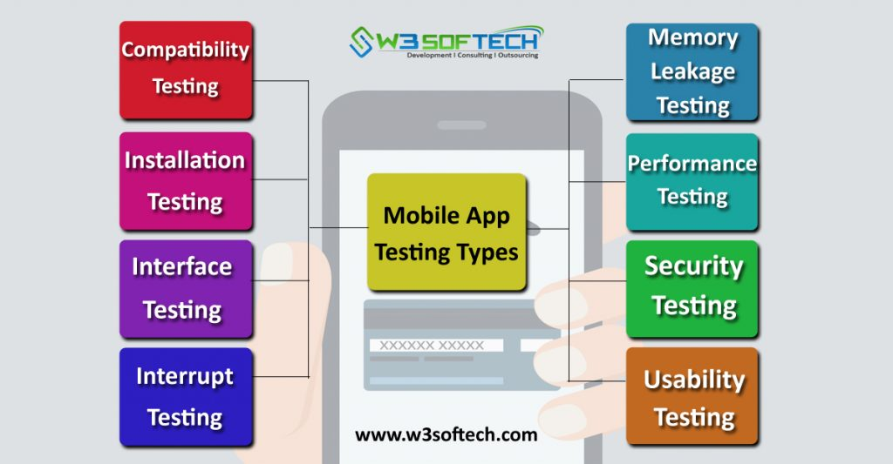
Mobile Application – Continuous Testing

Slide 13
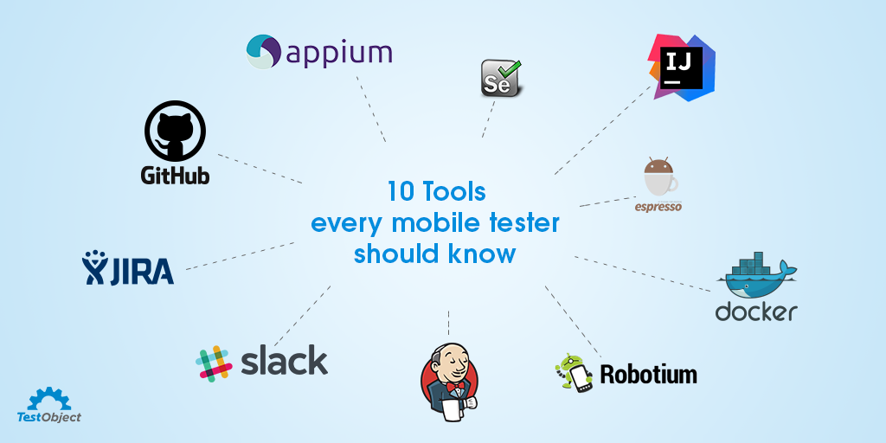
Mobile Application – Continuous Testing

Slide 14
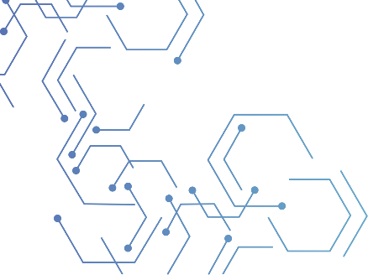

THANK YOU
^{THANK YOU}
Annual Performance Plan
2021 / 2022

